Slide 1
ICT 2103 Digital Logic Design
Prof. Dr. Muhammad Shahin Uddin
Email: shahin.uddin@mbstu.ac.bd

Slide 2
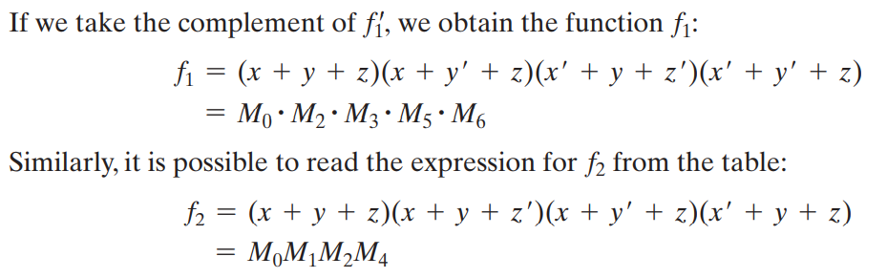
Canonical and Standard Form : Minterms and Maxterms
Boolean functions expressed as a sum of minterms or product of maxterms are said to be in canonical form.

Slide 3
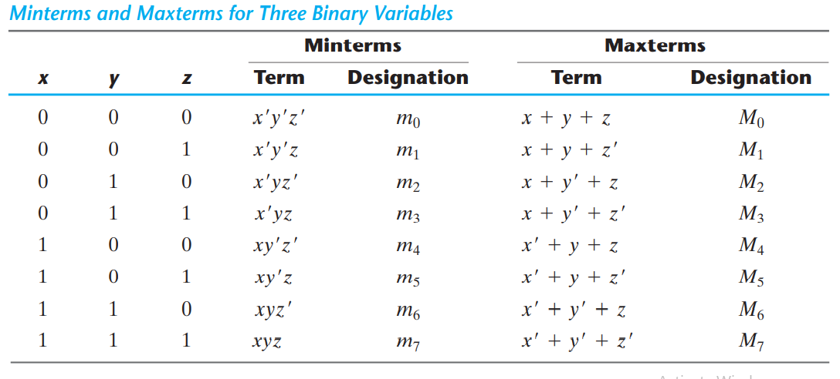
Canonical and Standard Form : Minterms and Maxterms

Slide 4
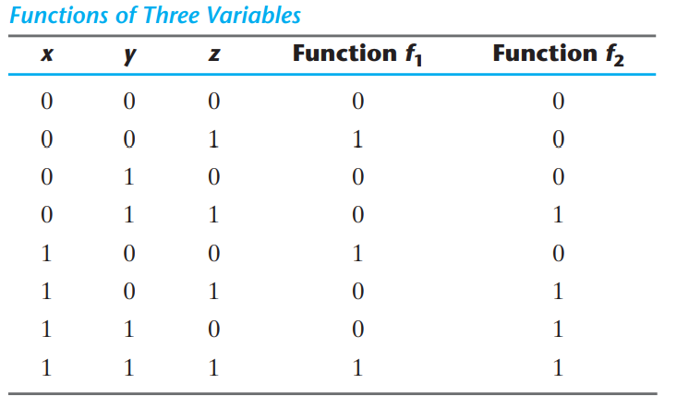
Canonical and Standard Form : Minterms and Maxterms

Slide 5
Sum of Minterms
The minterms whose sum defines the Boolean function are those which give the 1’s of the function in a truth table.
Function can be either 1 or 0 for each minterm, and since there are 2^{n} minterms
Convenient to express a Boolean function in its sum‐of‐minterms form.
If the function is not in this form, it can be made so by first expanding the expression into a sum of AND terms.
Each term is then inspected to see if it contains all the variables.
If it misses one or more variables, it is ANDed with an expression such as x + x, where x is one of the missing variables.
The next example clarifies this procedure.

Slide 6
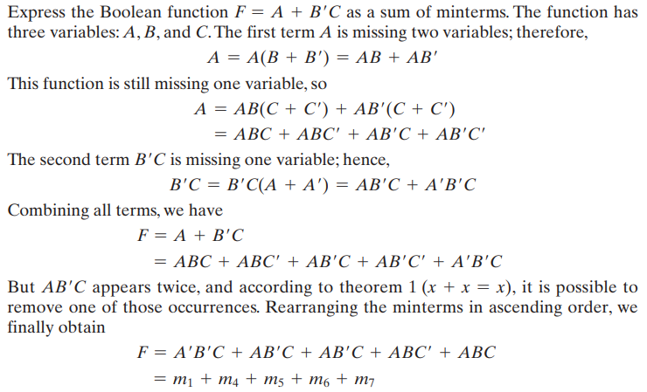
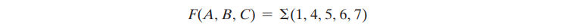
Example
It is sometimes convenient to express the function in the following brief notation.

Slide 7
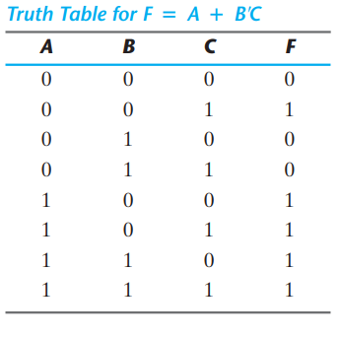
Alternative procedure for deriving the minterms
Consider the Boolean function given in previous Example
F = A + B’C
The truth table can be derived directly from the algebraic expression by listing the eight binary combinations under variables A, B, and C and inserting 1’s under F for those combinations for which A = 1 and BC = 01.
From the truth table, we can then read the five minterms of the function to be 1, 4, 5, 6, and 7.

Slide 8
Alternative procedure for deriving the minterms
Consider the Boolean function given in previous Example
F = A + B’C
The truth table can be derived directly from the algebraic expression by listing the eight binary combinations under variables A, B, and C and inserting 1’s under F for those combinations for which A = 1 and BC = 01.
From the truth table, we can then read the five minterms of the function to be 1, 4, 5, 6, and 7.

Slide 9
Alternative procedure for deriving the minterms
Consider the Boolean function given in previous Example
F = A + B’C
The truth table can be derived directly from the algebraic expression by listing the eight binary combinations under variables A, B, and C and inserting 1’s under F for those combinations for which A = 1 and BC = 01.
From the truth table, we can then read the five minterms of the function to be 1, 4, 5, 6, and 7.

Slide 10
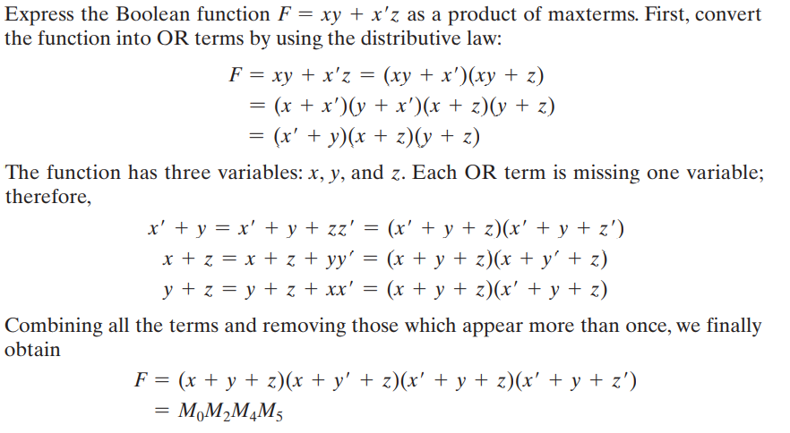
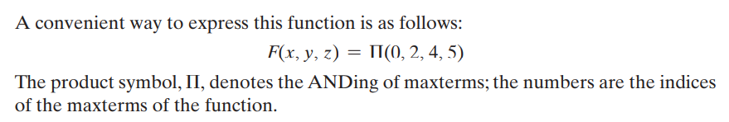
Example of Maxterms

Slide 11
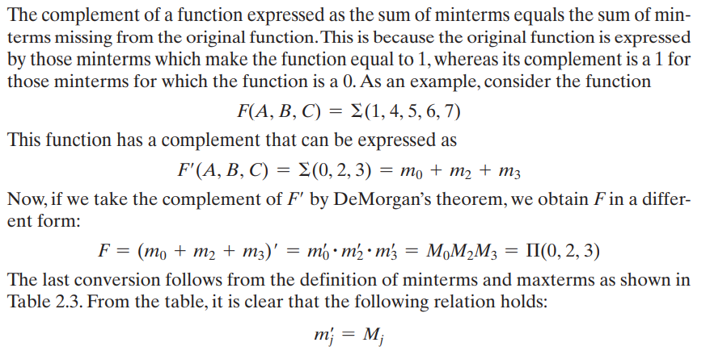
Conversion between Canonical Forms

Slide 12



Conversion between Canonical Forms
We now state a general conversion procedure:
To convert from one canonical form to another, interchange the symbols and
and list those numbers missing from the original form.
In order to find the missing terms, one must realize that the total number of minterms or maxterms is 2^{n} , where n is the number of binary variables in the function.
A Boolean function can be converted from an algebraic expression to a product of maxterms by means of a truth table and the canonical conversion procedure.
Consider, for example, the Boolean expression F = xy + x’z
First, we derive the truth table of the function
The 1’s under F in the table are determined from the combination of the variables for which xy = 11 or xz = 01.
The minterms of the function are read from the truth table to be 1, 3, 6, and 7.
The function expressed as a sum of minterms is
$$Σ$$
$$Π$$

Slide 13

Conversion between Canonical Forms
Since there is a total of eight minterms or maxterms in a function of three variables, we determine the missing terms to be 0, 2, 4, and 5. The function expressed as a product of maxterms is
the same answer as obtained in Previous Example.

Slide 14
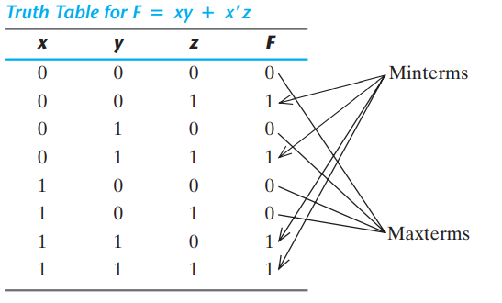
Conversion between Canonical Forms

Slide 15
Canonical Form: Sum of Minterms
F(X,Y,Z) = X’Y’+Z
= X’Y’(Z+Z’)+Z(X+X’)(Y+Y’)
= X’Y’Z+X’Y’Z’+(ZX+ZX’)(Y+Y’)
= X’Y’Z’+X’Y’Z+X’YZ+XY’Z+XYZ
= m0+m1+m3+m5+m7
= ∑(m0+m1+m3+m5+m7)
= ∑m(0,1,3.5,7)
Product of minterms 0,1,3.5.7

Slide 16
Canonical Form: Product of Maxterms
F(X,Y,Z) =X’Y’+Z
=Z+X’Y’
= (Z+X’)(Z+Y’) Using Distributed law
=(X’+YY’+Z)(XX’+Y’+Z)
=(X’+Y+Z)(X’+Y’+Z) (X+Y’+Z)(X’+Y+Z)
=(X’+Y+Z)(X’+Y’+Z) (X+Y’+Z)
=M₄M₆M₂
=∏(M₄M₆M₂) =∏M (2,4,6)
Product of Maxterm 2, 4, 6

Slide 17
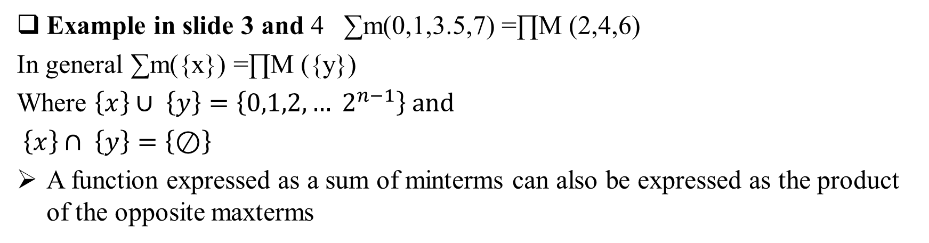
Canonical Forms
Example in slide 3 and 4 ∑m(0,1,3.5,7) =∏M (2,4,6)
In general ∑m({x}) =∏M ({y})
Where $\left\{x\right\}∪ \left\{y\right\}=\left\{0,1,2, … 2^{n−1}\right\} and$
$\left\{x\right\}∩ \left\{y\right\}=\left\{⊘\right\}$
A function expressed as a sum of minterms can also be expressed as the product of the opposite maxterms

Slide 18
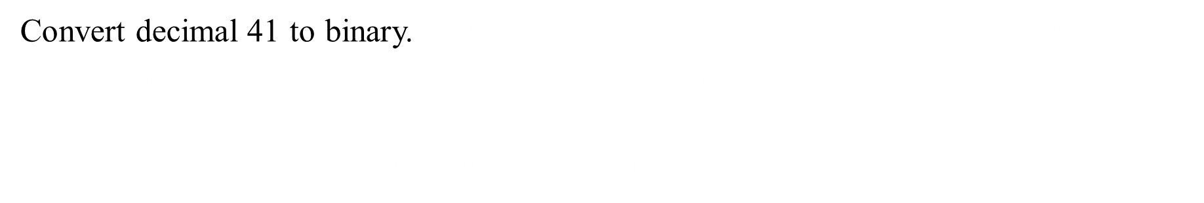
Canonical Forms: Minterms and Maxterms
A sum of minterms equals the inverse of the product of the same maxterms
$$\sum{m\left(\left\{x\right\}\right)=\overline{\prod{M(\left\{x\right\})}}}$$
Proof:
$$\overline{\prod{M(\left\{x\right\})}}=\overline{\left(M_{x_{1}}.M_{x_{2}}……M_{x_{k}}\right)}$$
$=\overline{M_{x_{1}}}+\overline{M_{x_{2}}}+…\overline{M_{x_{k}}}$
$$=m_{x_{1}}+m_{x_{2}}+…+m_{x_{k}}$$
$$=\sum{m\left(\left\{x\right\}\right)}$$

Slide 19
Canonical/Standard Forms
There are two types of standard forms:
Sum of products (SOP) and
Products of sums (POS).

Slide 20
Sum of Product (SOP)
0
SOP form
POS form
1
Directly written from Truth Table
0
1
1
Canonical/ Standard form
F=x’yz’+xy’z’+xy’z+xyz’+xyz
= x’yz’+xy’[z’+z]+xy[z’+z]
=x’yz’+xy’+xy
=x’yz’+x[y’+y]
= x’yz’+x
= x+yz’ [Distributed law A+A’B=A+B)]
Each minterm is having all the variable or complemented form
Each minterm does not have all the variables in normal or complemented form
Minimal SOP form

Slide 21
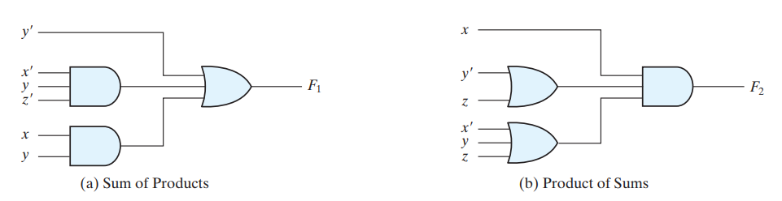
Standard Forms: Two‐level implementation
y’+x’yz’+xy

Slide 22
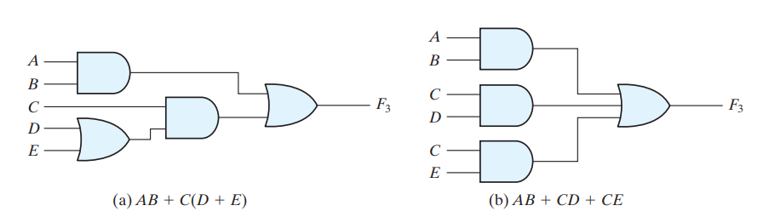
Standard Forms: Conversion from other form
A Boolean function may be expressed in a nonstandard form
Example: F₃ = AB + C(D + E)
Neither in sum‐of‐products nor in product‐of‐sums form.
Two-level produces the least amount of delay through the gates when the signal propagates from the inputs to the output.
Sum of Product
3-> 2 level

Slide 23
Constructing Gates
Transistor
A device that acts either as a wire that conducts electricity or as a resistor that blocks the flow of electricity, depending on the voltage level of an input signal
A transistor has no moving parts, yet acts like a switch
It is made of a semiconductor material, which is neither a particularly good conductor of electricity nor a particularly good insulator

Slide 24
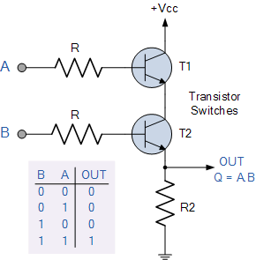
How is the behavior implemented
B
E

Slide 25
Circuits
Combinational Circuit
The input values explicitly determine the output
Sequential Circuit
The output is a function of the input values and the existing state of the circuit

Slide 26
Combinational Circuits
Output is function of input only
i.e. no feedback
When input changes, output may change (after a delay)
Combinational
Circuits
n inputs
m outputs
•
•
•
•
•
•
✗

Slide 27
Combinational Circuits
Example:
Adder
Subtractor
Decoder
MUX
DeMUX
Code Converters
Comparator
ROM
PLA
PAL

Slide 28
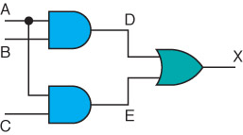
Combinational Circuits
Gates are combined into circuits by using the output of one gate as the input for another

Slide 29

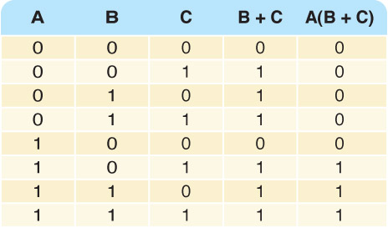
Combinational Circuits
Consider the following Boolean expression A(B + C)

Slide 30
Combinational Circuits
Analysis
Given a circuit, find out its function
Function may be expressed as:
Boolean function
Truth table
Design
Given a desired function, determine its circuit
Function may be expressed as:
Boolean function
Truth table
?
?
?

Slide 31
Analysis Procedure
Boolean Expression Approach
T₂=ABC
T₁=A+B+C
T₃=AB'C'+A'BC'+A'B'C
F’₂=(A’+B’)(A’+C’)(B’+C’)
F₂=AB+AC+BC
F₁=AB'C'+A'BC'+A'B'C+ABC
F₂=AB+AC+BC

Slide 32
Analysis Procedure
Truth Table Approach
A B C | F₁ | F₂
0 0 0
= 0
= 0
= 0
= 0
= 0
= 0
= 0
= 0
= 0
= 0
= 0
= 0
0 0
0
0
0
0
0
0
0
1
0

Slide 33
Analysis Procedure
Truth Table Approach
A B C | F₁ | F₂
0 0 0 | 0 | 0
0 0 1
= 0
= 0
= 1
= 0
= 0
= 1
= 0
= 0
= 0
= 1
= 0
= 1
0
1
0
0
0
1
1 0
1
1
0

Slide 34
Analysis Procedure
Truth Table Approach
A B C | F₁ | F₂
0 0 0 | 0 | 0
0 0 1 | 1 | 0
0 1 0
= 0
= 1
= 0
= 0
= 1
= 0
= 0
= 1
= 0
= 0
= 1
= 0
0
1
0
0
0
1
1 0
1
1
0

Slide 35
Analysis Procedure
Truth Table Approach
A B C | F₁ | F₂
0 0 0 | 0 | 0
0 0 1 | 1 | 0
0 1 0 | 1 | 0
0 1 1
= 0
= 1
= 1
= 0
= 1
= 1
= 0
= 1
= 0
= 1
= 1
= 1
0
1
0
0
1
0
0
0 1
0
1

Slide 36
Analysis Procedure
Truth Table Approach
A B C | F₁ | F₂
0 0 0 | 0 | 0
0 0 1 | 1 | 0
0 1 0 | 1 | 0
0 1 1 | 0 | 1
1 0 0
= 1
= 0
= 0
= 1
= 0
= 0
= 1
= 0
= 1
= 0
= 0
= 0
0
1
0
0
0
1
1
1
1 0
0

Slide 37
Analysis Procedure
Truth Table Approach
A B C | F₁ | F₂
0 0 0 | 0 | 0
0 0 1 | 1 | 0
0 1 0 | 1 | 0
0 1 1 | 0 | 1
1 0 0 | 1 | 0
1 0 1
= 1
= 0
= 1
= 1
= 0
= 1
= 1
= 0
= 1
= 1
= 0
= 1
0
1
0
1
0
0
0
0
0 1
1

Slide 38
Analysis Procedure
Truth Table Approach
A B C | F₁ | F₂
0 0 0 | 0 | 0
0 0 1 | 1 | 0
0 1 0 | 1 | 0
0 1 1 | 0 | 1
1 0 0 | 1 | 0
1 0 1 | 0 | 1
1 1 0
= 1
= 1
= 0
= 1
= 1
= 0
= 1
= 1
= 1
= 0
= 1
= 0
0
1
1
0
0
0
0
0
0 1
1

Slide 39
Analysis Procedure
Truth Table Approach
A B C | F₁ | F₂
0 0 0 | 0 | 0
0 0 1 | 1 | 0
0 1 0 | 1 | 0
0 1 1 | 0 | 1
1 0 0 | 1 | 0
1 0 1 | 0 | 1
1 1 0 | 0 | 1
1 1 1
= 1
= 1
= 1
= 1
= 1
= 1
= 1
= 1
= 1
= 1
= 1
= 1
1
1
1
1
1
1
0
0
1
1 1
 |  |  |  | B
 |  | 0 | 1 | 0 | 1
A |  | 1 | 0 | 1 | 0
 |  |  | C
 |  |  |  | B
 |  | 0 | 0 | 1 | 0
A |  | 0 | 1 | 1 | 1
 |  |  | C
Minimization using K-Map
Discuss later ….
F₁=AB'C'+A'BC'+A'B'C+ABC
F₂=AB+AC+BC

Slide 40
Design Procedure
Given a problem statement:
Determine the number of inputs and outputs
Derive the truth table
Simplify the Boolean expression for each output
Produce the required circuit

Slide 41
Analysis Procedure
Truth Table Approach
A B C | F₁ | F₂
0 0 0 | 0 | 0
0 0 1 | 1 | 0
0 1 0 | 1 | 0
0 1 1 | 0 | 1
1 0 0 | 1 | 0
1 0 1 | 0 | 1
1 1 0 | 0 | 1
1 1 1
= 1
= 1
= 1
= 1
= 1
= 1
= 1
= 1
= 1
= 1
= 1
= 1
1
1
1
1
1
1
0
0
1
1 1
Minimization using K-Map
 |  |  |  | B
 |  | 0 | 1 | 0 | 1
A |  | 1 | 0 | 1 | 0
 |  |  | C
 |  |  |  | B
 |  | 0 | 0 | 1 | 0
A |  | 0 | 1 | 1 | 1
 |  |  | C
F₁=AB'C'+A'BC'+A'B'C+ABC
F₂=AB+AC+BC

Slide 42
Gate-Level Minimization
Gate-level minimization is the design task of finding an optimal gate-level implementation of the Boolean functions describing a digital circuit.
This task is well understood, but is difficult to execute by manual methods when the logic has more than a few inputs

Slide 43
The Map Method
The complexity of the digital logic gates
The complexity of the algebraic expression
Logic minimization
Algebraic approaches: lack specific rules
The Karnaugh map
A simple straight forward procedure
A pictorial form of a truth table
Applicable if the # of variables < 7
A diagram made up of squares
Each square represents one minterm

Slide 44
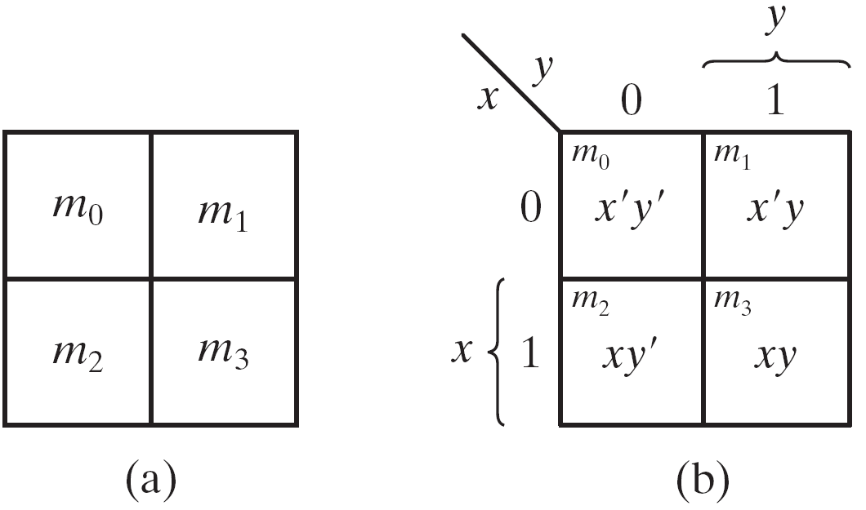
The Map Method
Boolean expressions may be simplified by algebraic means.
It is also known as the Karnaugh map or K-map .
A simple straight forward procedure
A pictorial form of a truth table
Applicable if the # of variables < 7
A diagram made up of squares
Each square represents one minterm/maxterms
Boolean function can be expressed as a sum of minterms.
The simplified expressions produced by the map are two standard forms:
Sum of products (SoP)
Product of sums (PoS)
The expression produces a circuit diagram with
a minimum number of gates and
the minimum number of inputs to each gate.

Slide 45
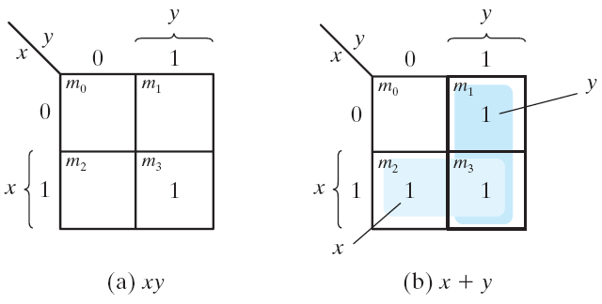
Two-Variable Map
Fig. 1 Two-variable Map
A two-variable map (Fig. 1)
Four minterms
Four squares, one for each minterm.
x' = row 0; x = row 1
y' = column 0; y = column 1
The map is redrawn in Fig.1(b):
To show the relationship between the squares and the variables x and y .
The 0 and 1 marked in each row and column designate the values of variables.
Fig. 2 Representation of functions in the map
A truth table in square diagram
Fig. 2(a): xy = m₃
Fig. 2(b): x+y = x'y+xy' +xy= m₁+m₂+m₃

Slide 46
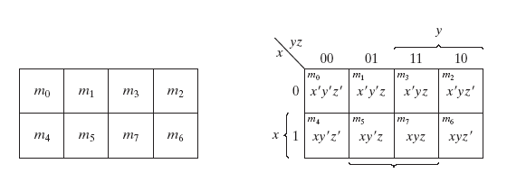
Three-variable Map
A three-variable map
Eight minterms
The Gray code sequence
Any two adjacent squares in the map differ by only on variable
Primed in one square and unprimed in the other
e.g., m₅ and m₇ can be simplified
m₅+ m₇ = xy'z + xyz = xz (y'+y) = xz
x’yz+x’yz’=x’y(z+z’)=x’y.1=x’y
Three-variable Map

Slide 47
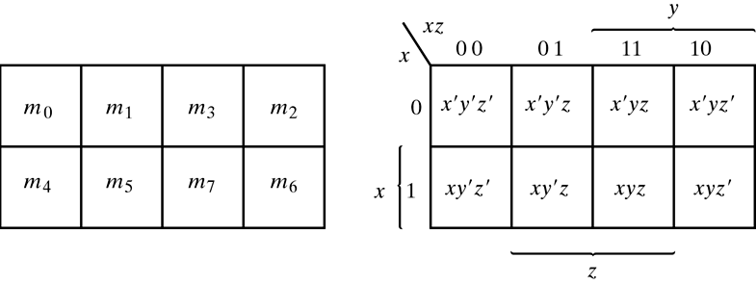
Three-variable Map
m₀ and m₂ (m₄ and m₆) are adjacent
m₀+ m₂ = x'y'z' + x'yz' = x'z' (y'+y) = x'z'
m₄+ m₆ = xy'z' + xyz' = xz' (y'+y) = xz'
Three-variable Map

Slide 48
Karnaugh Maps - Rules of Simplification
Summary:
No zeros allowed.
No diagonals.
Only power of 2 number of cells in each group.
Groups should be as large as possible.
Every one must be in at least one group.
Overlapping allowed.
Wrap around allowed.
Fewest number of groups possible.

Slide 49
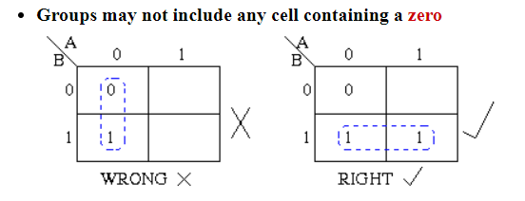
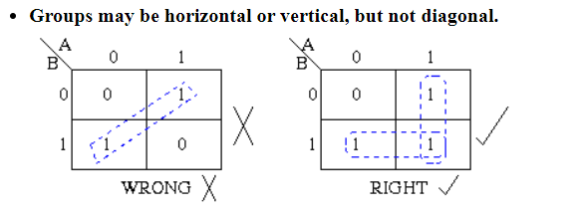
Karnaugh Maps - Rules of Simplification

Slide 50
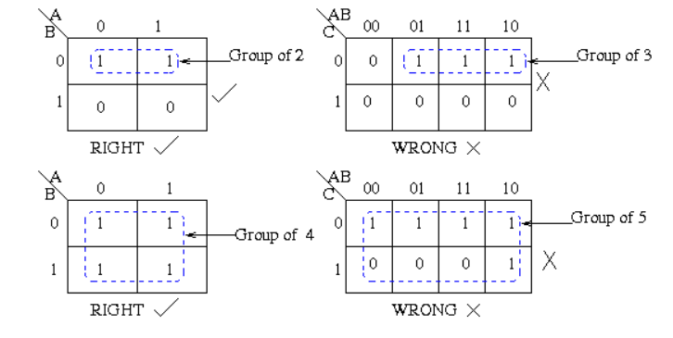
Karnaugh Maps - Rules of Simplification

Slide 51
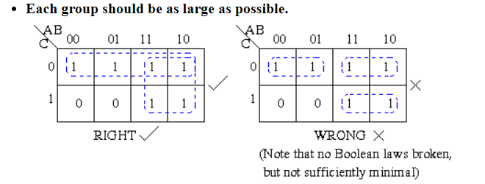
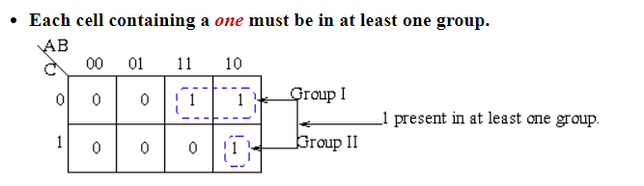
Karnaugh Maps - Rules of Simplification

Slide 52
Karnaugh Maps - Rules of Simplification

Slide 53
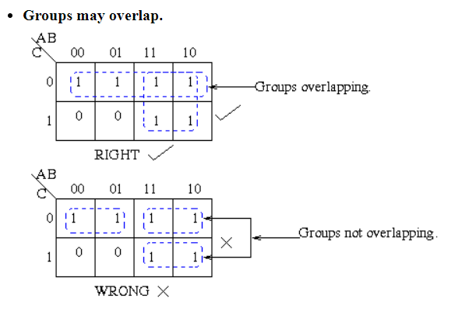
Karnaugh Maps - Rules of Simplification

Slide 54
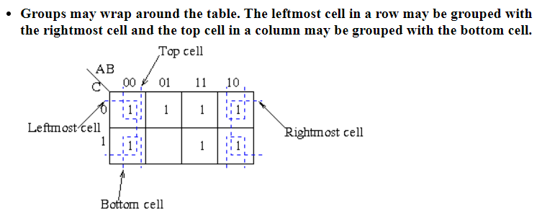
Karnaugh Maps - Rules of Simplification

Slide 55
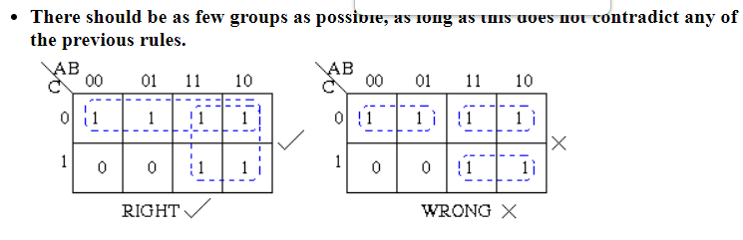
Karnaugh Maps - Rules of Simplification

Slide 56
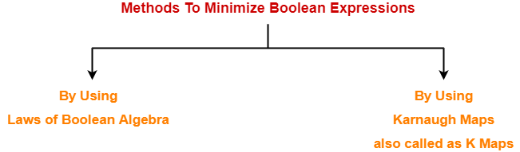
Minimization Techniques

Slide 57
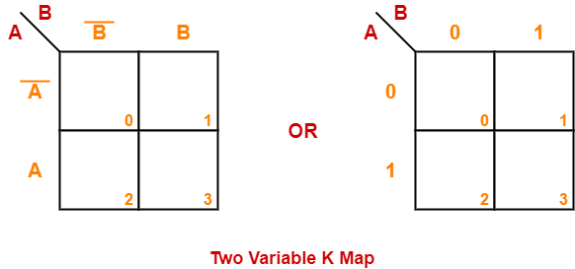

Slide 58
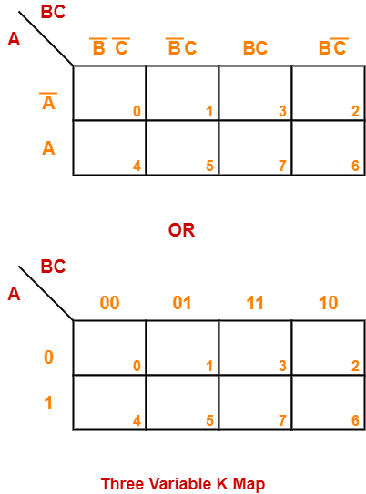

Slide 59
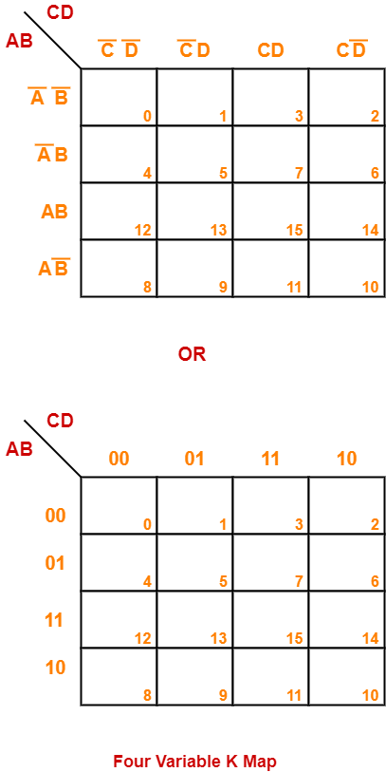

Slide 60
Problem-01: Minimize the following boolean function- F(A, B, C, D) = Σm(0, 1, 2, 5, 7, 8, 9, 10, 13, 15)

Slide 61
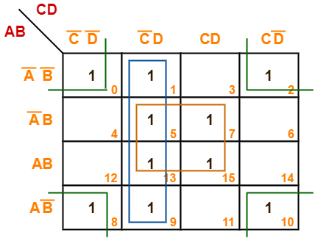
Now, F(A, B, C, D) = (A’B + AB)(C’D + CD) + (A’B’ + A’B + AB + AB’)C’D + (A’B’ + AB’)(C’D’ + CD’) = BD + C’D + B’D’ Thus, minimized Boolean expression is- F(A, B, C, D) = BD + C’D + B’D’

Slide 62
Problem-02: Minimize the following boolean function- F(A, B, C, D) = Σm(0, 1, 3, 5, 7, 8, 9, 11, 13, 15)

Slide 63
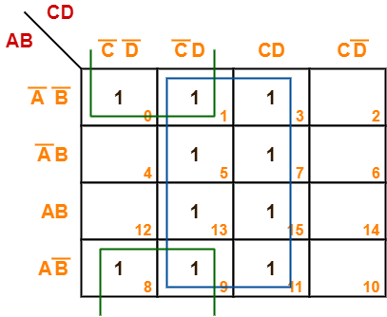
Problem-02: Minimize the following boolean function- F(A, B, C, D) = Σm(0, 1, 3, 5, 7, 8, 9, 11, 13, 15)
F(A, B, C, D) = B’C’ + D

Slide 64
Problem-03: Minimize the following boolean function- F(A, B, C, D) = Σm(1, 3, 4, 6, 8, 9, 11, 13, 15) + Σd(0, 2, 14)

Slide 65
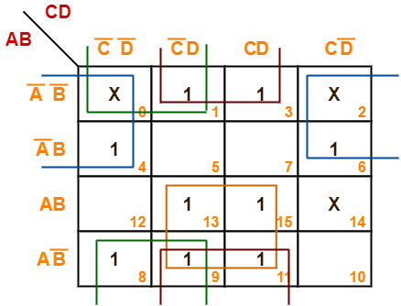
Problem-03: Minimize the following boolean function- F(A, B, C, D) = Σm(1, 3, 4, 6, 8, 9, 11, 13, 15) + Σd(0, 2, 14)
F(A, B, C, D) = AD + B’D + B’C’ + A’D’

Slide 66
Thanks

